Slide 1
Applied Statistical Analysis
EDUC 6050
Week 1
Finding clarity using data

Slide 2
Welcome
What is quantitative research?
How does data inform our world?
How are data analyzed?

Slide 3
Data, Data, Data, Data, Data, ...
Tesla Autopilot

Slide 4
Data, Data, Data, Data, Data, ...

Slide 5
Data, Data, Data, Data, Data, ...
Health Care Policy and Cost

Slide 6
Data are/is Cool
“In God we trust. All others must bring data.”
W. Edwards Deming
“It is a capital mistake to theorize before one has data.”
Sherlock Holmes, “A Study in Scarlett” (Arthur Conan Doyle).
“You can have data without information, but you cannot have information without data.”
Daniel Keys Moran

Slide 7
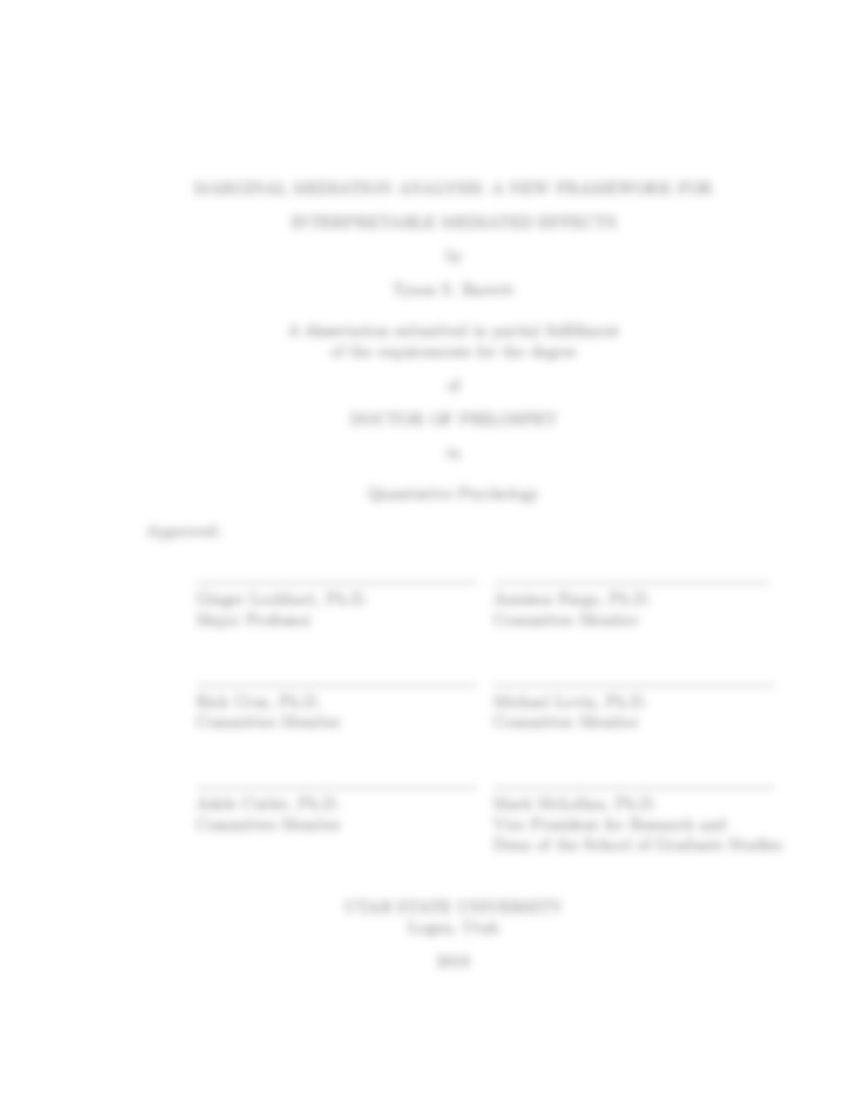

Purpose of this course
Develop quantitative understanding and skills
Prepare you for:
Your thesis
Your career
Notes:
Thesis: perform you own analyses and interpret them
Career: communicate with, work with, and understand statisticians and data scientists that you will be working with (they are everywhere…)

Slide 8
What is expected of you
Attend and participate in class
Prepare for class (readings before class)
Professional correspondence with colleagues
Use assignments to learn
Ask questions
Communicate with me

Slide 9
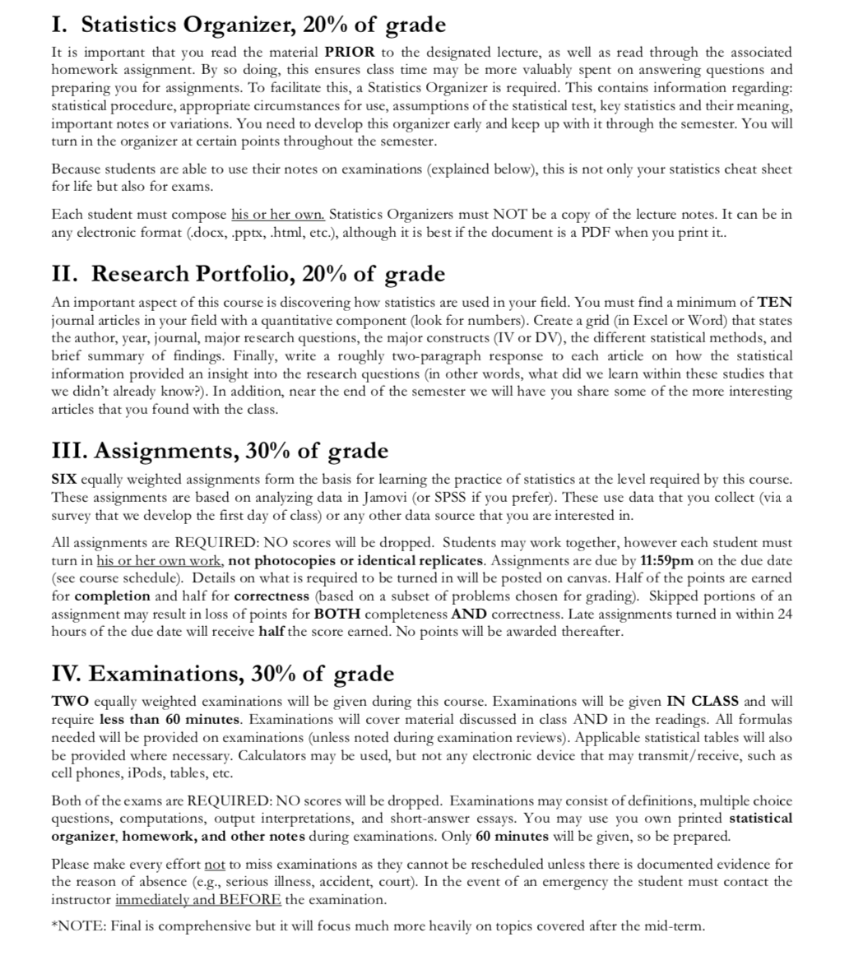
Grading

Slide 10
Grading
Statistics Organizer
20% of Grade
You decide how it looks
-> Can use on Exams

Slide 11
Grading
Research Portfolio
20% of Grade
10 journal articles in your area using quantitative research

Slide 12
Grading
Assignments
30% of Grade
6 applied assignments using Jamovi (or SPSS)

Slide 13
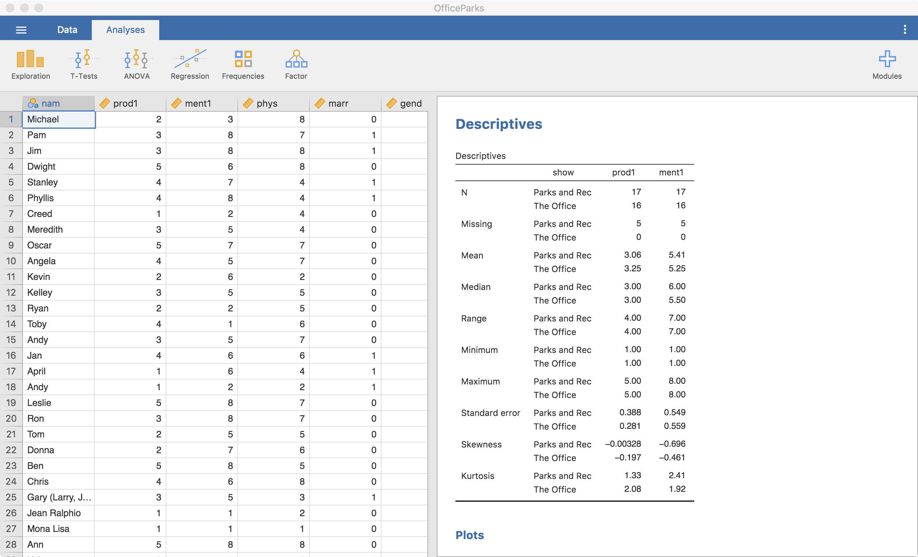
Jamovi

Slide 14
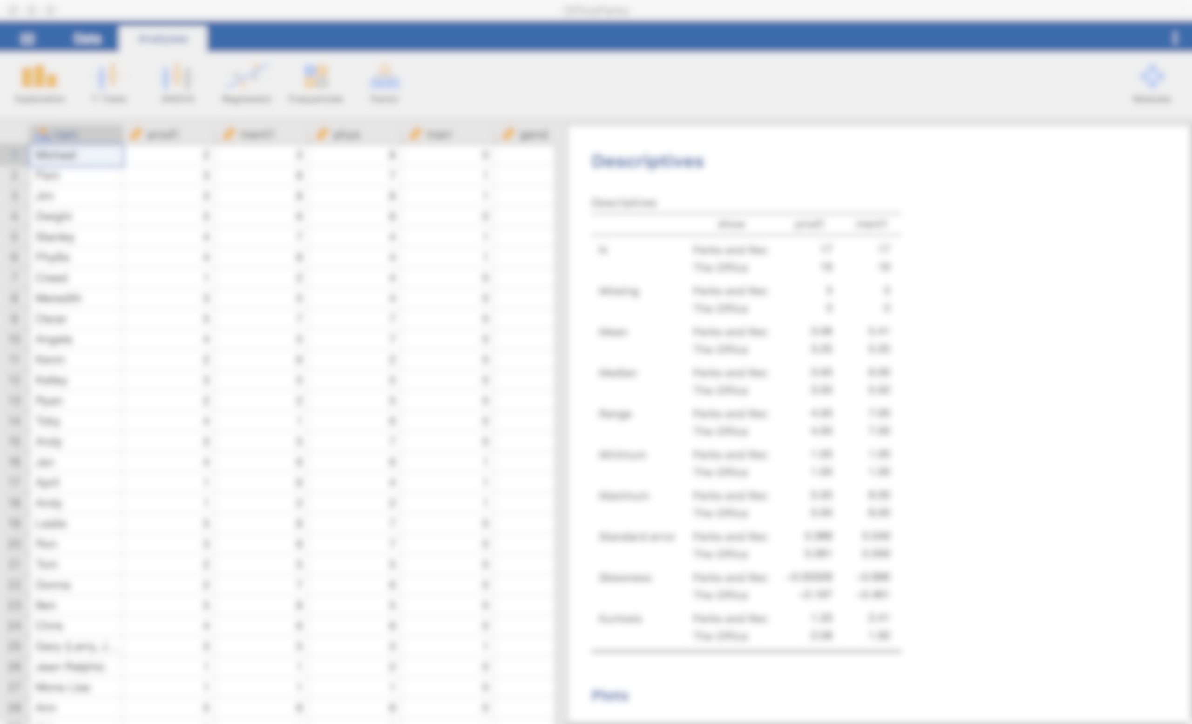
Jamovi
Free
Based on Spreadsheets (like Excel or Google Sheets)
Similar to SPSS (simpler, fewer abilities)
Point-and-click
Data and analyses saved together

Slide 15
Grading
Examinations
30% of Grade
2 open note exams

Slide 16
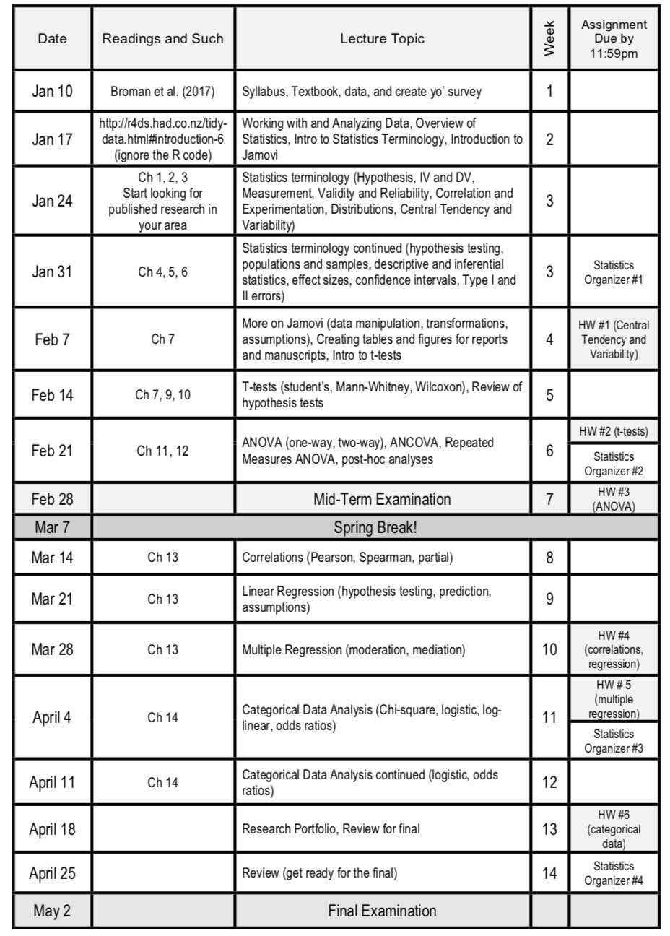
Schedule
Tentative
Readings are due before class
Assignment by the end of the day

Slide 17
Schedule
Tentative
Readings are due before class
Assignment by the end of the day
Please read the
syllabus in depth

Slide 18
Break Time

Slide 19
Tell us about yourself
During the break, please go to:
https://docs.google.com/spreadsheets/d/1JaggNgUtkdzQ9T-FTNDsvf0D6DRM1psMJZvcKuYSaxI/edit?usp=sharing
first_name: your first name
degree: the degree you’re pursuing
grow_up: what you want to do when you grow up
hobby: one of your hobbies
where_from: where are you from?
where_end: where do you want to end up living
would_rather: fly or money?

Slide 20
Tell us about yourself
During the break, please go to:
https://docs.google.com/spreadsheets/d/1JaggNgUtkdzQ9T-FTNDsvf0D6DRM1psMJZvcKuYSaxI/edit?usp=sharing
We will practice with Jamovi next week using this data
first_name: your first name
degree: the degree you’re pursuing
grow_up: what you want to do when you grow up
hobby: one of your hobbies
where_from: where are you from?
where_end: where do you want to end up living
would_rather: fly or money?

Slide 21
Data and spreadsheets
Get used to working with spreadsheets
Excel, Google Sheets, Numbers, etc.

Slide 22
Good data practices
Save a master data file that does not change after you have cleaned up the file
Do NOT save subsetted data files (e.g., removed all ages < 20)
Instead save the analyses
Save the master file on multiple devices (flash drive, cloud, computer)
Broman et al. (2017)

Slide 23
Good data practices
Double check your work
Re-run the same analyses after closing down the file and software
Keep track of all your data and analysis
Broman et al. (2017)

Slide 24
Break Time

Slide 25
Assignments require your own data
You can use any data that you’d like, if:
It has both continuous and categorical variables
It has at least 20 participants
It is available for you to use in class (de-identified)

Slide 26
Assignments require your own data
Continuous is where the values of the variable can be a wide, continuous range
You can use any data that you’d like, if:
It has both continuous and categorical variables
It has at least 20 participants
It is available for you to use in class (de-identified)

Slide 27
Assignments require your own data
Categorical is where the values of the variable can only be a few, predefined values
You can use any data that you’d like, if:
It has both continuous and categorical variables
It has at least 20 participants
It is available for you to use in class (de-identified)

Slide 28
Create a survey
Use a survey to collect data that you can use for this class
Needs to meet the requirements of the data
Example

Slide 29
Questions?

Slide 30
Next week:
Working with Data
Overview of Statistics
Intro to Statistical Terminology
Intro to Jamovi

